Slide 1
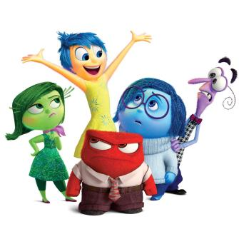
Emotional Regulation within infant-aged children.

Slide 2

Our emotions need to be as educated as our intellect. It is important to know how to feel, how to respond and how to use this in your life – Anonymous

Slide 3
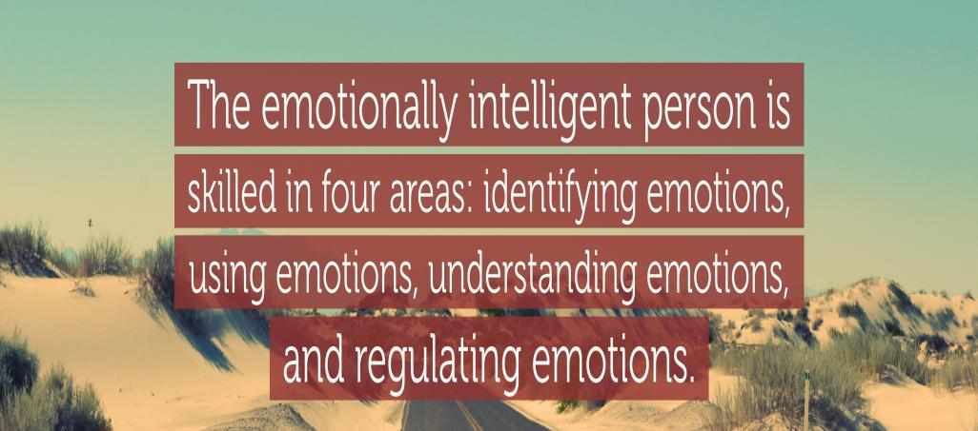

Slide 4
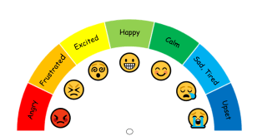
Emotional Regulation
All emotions are there for a reason. We can’t change how we feel.
However, we can help children to monitor, evaluate and regulate their emotional response.
These processes are responsible for regulating the emotional reactions in order to meet a goal.
Notes:
Top down/ Bottom up - Top down cognitive response from learnt emotional intelligence and behaviour strategies. Bottom up reactive.
Extrinsic – not part of individuals nature, coming form outside. Parents, siblings, teachers, LSAs lunchtime staff, low sensory classroom, environment –
Intrinsic – belonging naturally – ASD Fenning, Baker and Moffitt in 2018 found that - ASD symptom severity emerged as the strongest predictor of child emotion dysregulation across contexts.
Diagnostic criteria for autism spectrum disorder (ASD) focus on core deficits in social communication and the presence of restricted and repetitive behaviours (American Psychiatric Association, 2013). However, individuals with ASD also experience high rates of co-occurring emotional and behavioural challenges (Brereton, Tonge, & Einfeld, 2006; Georgiades et al., 2013), which has prompted efforts to better understand mechanisms underlying heterogeneity (diversity ) n this population. Emotion regulation, or the ability to modulate emotional states to achieve a goal (Gross, 2008; Thompson, 1994), has been posited to play a central role in the manifestation of individual differences in core ASD-related symptomatology and comorbid problems,

Slide 5
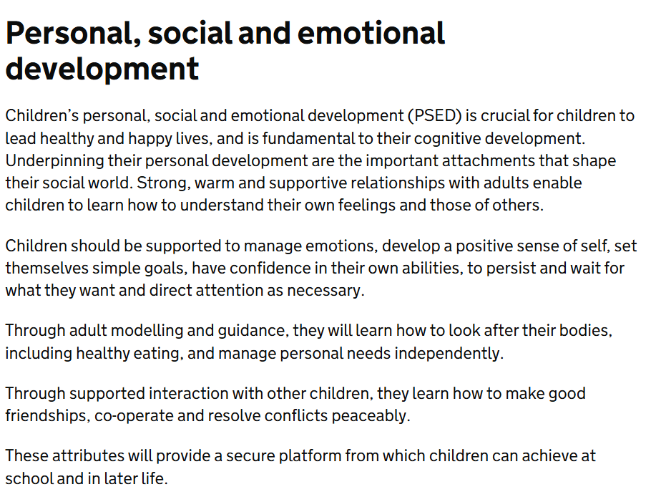










Slide 6
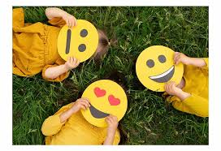
Research shows that children who understand their feelings and learn about their emotions have these advantages:
They form stronger friendships with other children.
They calm themselves down more quickly when they get upset.
They do better in school.
They handle their moods better and have fewer negative emotions.
They have the tools to cope with stress.
They can manage their emotions which will support them throughout adulthood.
They get sick less often.
They will grow in confidence by completing tasks more independently.

Slide 7
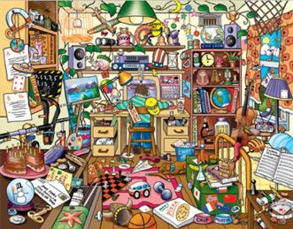


How do you feel when?
How do you regulate your emotion?

Slide 8
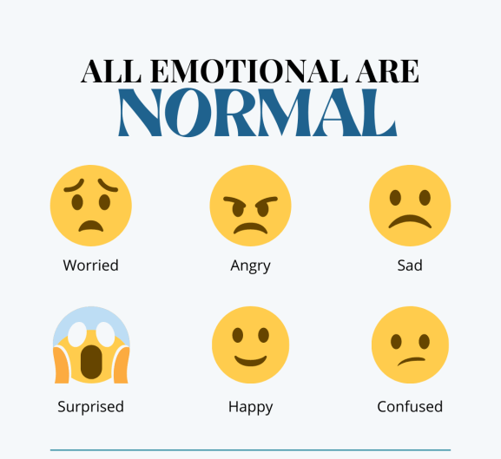
All emotions are

Slide 9

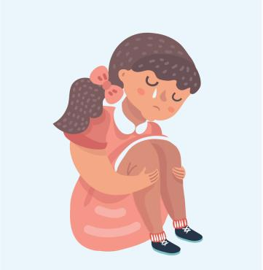
It is the reactions that we can help support.

Slide 10
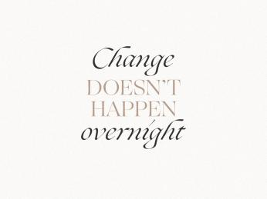
Children are going to get upset, angry etc.
There isn’t a simple fix, just as it comes to adults and their own emotions.
However, it is a journey that will support the children for the rest of their lives.

Slide 11

We want children to understand that it is healthy to talk about emotions.
We want them to express themselves.
We also want them to identify how to regulate themselves when they are feeling a particular emotion.

Slide 12
We have a few strategies that might help support at home…

Slide 13
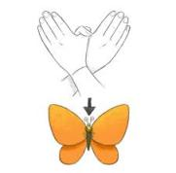
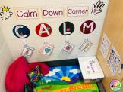
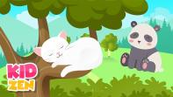
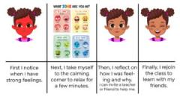

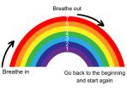
Calm corners.
Butterfly hugs
Relaxing music
Social Stories
Visuals
Rainbow Breathing

Slide 14

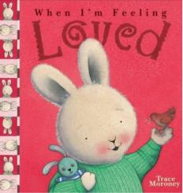
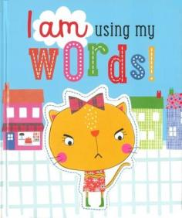
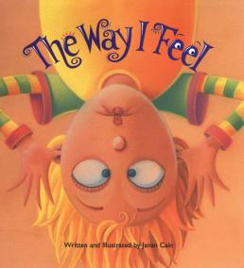

Slide 15

Emotion Coaching
This technique helps children understand their feelings. Children learn how emotions work and how to react to feelings in healthy ways.

Slide 16
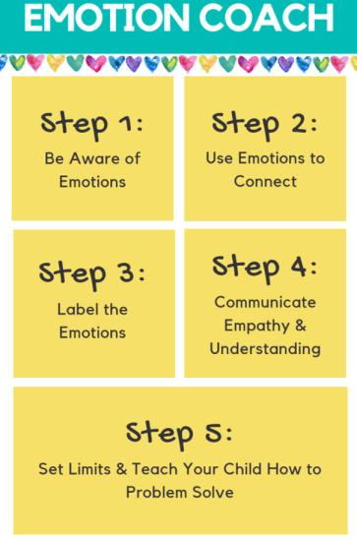
STEP 1 – Be aware of emotions
Tune in to your child’s feelings and your own.
Observe, listen, and learn how your child expresses different emotions.
Watch for changes in facial expressions, body language, posture, and tone of voice.
STEP 2 – Connect with your child
Use emotional moments as opportunities to connect.
Recognize feelings and encourage your child to talk about his or her emotions.

Slide 17
STEP 3 – Listen to your child
Respect your child’s feelings by taking time to listen carefully.
Show your child that you understand what he or she is feeling.
STEP 4 – Name emotions
Help your child identify and name emotions.
Identify the emotions your child is experiencing instead of telling your child how he or she should feel.

Slide 18
STEP 5 – Find good solutions
Explore solutions to problems together.
Help them identify their feelings and explain why their behaviour was inappropriate.
Encourage emotional expression, but set clear limits on behaviour.

Slide 19
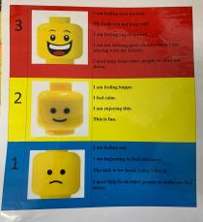
Reception
3-point Lego scale:
1 is sad, 2 is happy, 3 is angry/overexcited
It is discussed within circle times that these feelings are ok but how can we get back to number 2.
Calm corner: Lego heads for 'how are we feeling today?' - modelled by teacher but children are taught to use this independently to communicate how they are feeling.

Slide 20
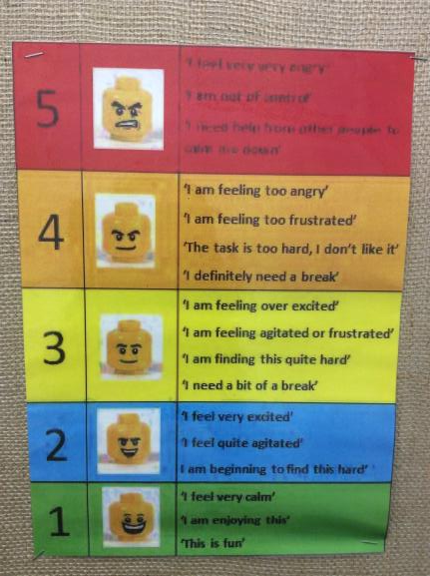
Year 1
The Lego men posters is extended from a three-point scale to a five-point scale.
The children come in and find their star to put on a feelings poster to indicate how they are feeling every morning. The children can then move their star to a different feeling at any point during the day.

Slide 21
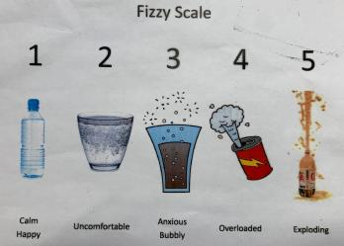
The children also use the fizzy scale and liken it to like fizzy water in a bottle
When you are getting to a 5, means your feelings might explode like shaking the fizzy water in a bottle and it exploding out.
The children can really relate to this and start to learn to indicate where they are on the scale (1=calm, happy, 2=uncomfortable, 3= bubbly, 4=overloaded, 5=exploding).
Circle times reinforce the scale by referring to it ourselves and how we feel in certain situations.

Slide 22

Year 2 – Zones of Regulation
There are 4 zones to catagorise feeling and corresponding tools.
No ‘bad’ zone
Appropriate to be in all zones (have all feelings) at different times across different environments.
Can be in more than one zone at a time
Lessons to introduce curriculum
Not a scripted programme can be modified to fit your needs.

Slide 23
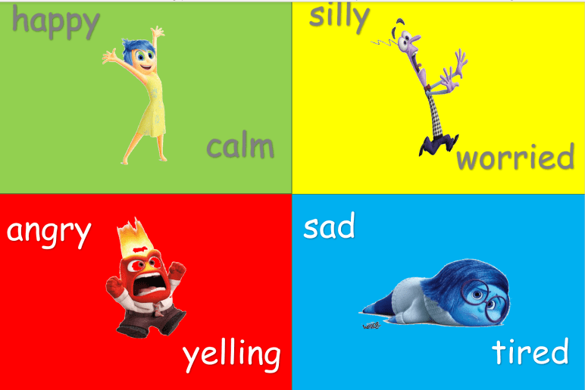

Slide 24
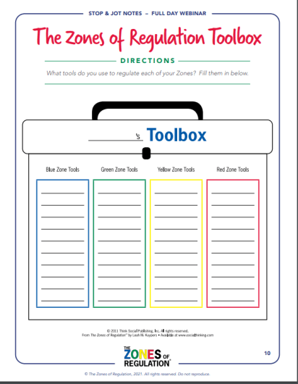
Create a toolbox.
Blue Zone tools: help wake up our bodies, feel better and regain focus. Green Zone tools: help us stay calm, focused and feeling good. These are often proactive strategies.
Yellow Zone tools: help us regain control and calm ourselves.
Red Zone tools: help us stay safe and start to calm down.
Notes:
Once we have identified the emotions – we then look at what we could do to regulate ourselves. We call this the toolbox.
Effective tools worksheet
In the stop and jot.
The we have tools to manage these.
Try to think of some tools you could use and what zones they would be in.
Green zone – might be about staying in that zone!
Do this as class and then create a list of tools you can use.

Slide 25
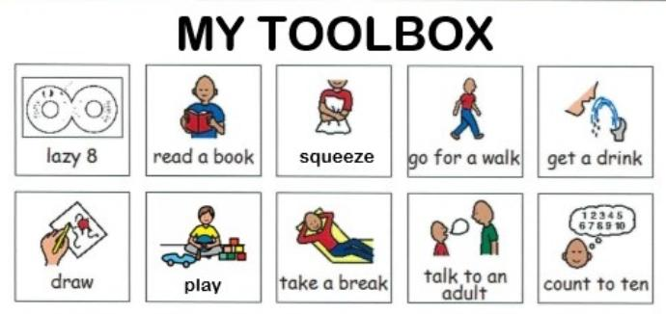

Slide 26

Language used.
I am feeling in the blue zone because…
I think you might be in the red zone because
You are stamping your feet. Am I correct?

Slide 27


Slide 28
